Slide 1
Virtual Reality Client Proposal
Liam Burke and John Miscevich

Slide 2
Acknowledgements
Client, Project Sponsor, and Faculty Advisor:
Dr. Elmer Grubbs
Burke

Slide 3
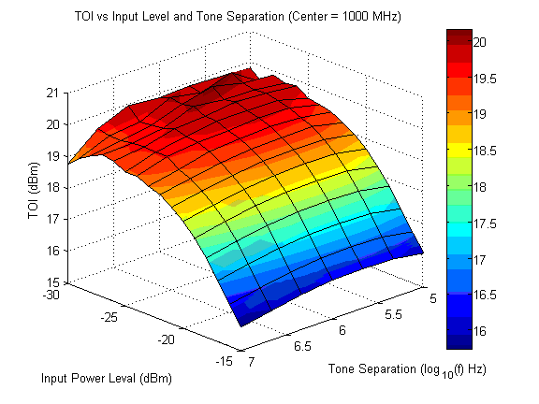
Problem Statement and Desired Outcome
Integrate virtual reality environment and motion based controls
Iconic representation of sorted data
Integrate data representation with virtual reality environment
Utilize motion controls to manipulate data representation
Burke

Slide 4
Applications and Benefits
Exciting, engaging way to view and analyze data sets
Used easily and intuitively – no complex controls or software to learn
Burke

Slide 5
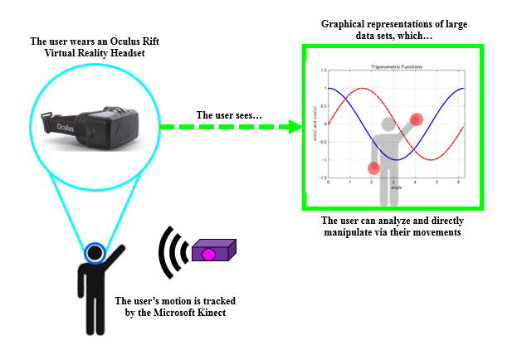
Systems Overview Diagram
Burke

Slide 6
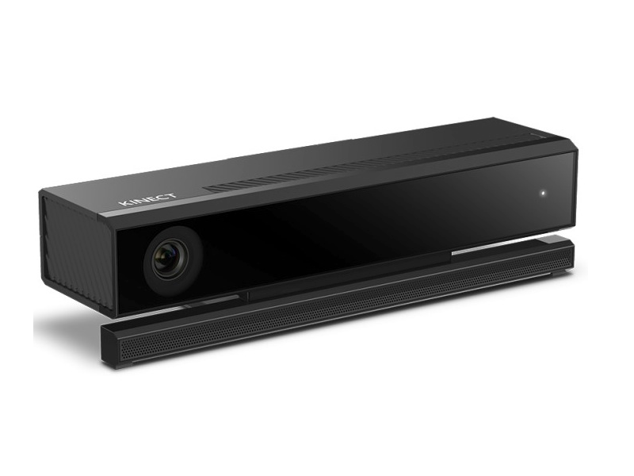
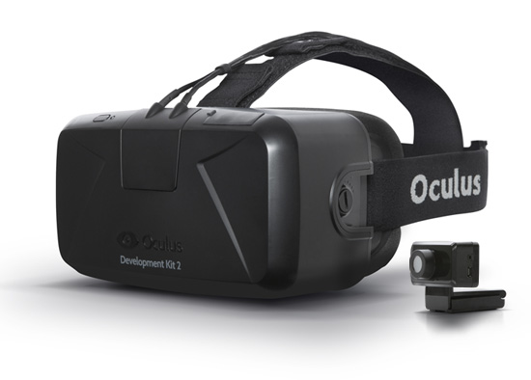
Requirements and Specifications
The requirements and specifications, for the most part, have been relatively unchanged
Unity 3D Engine
Oculus Rift DK2
Microsoft Kinect
All unchanged, per the client’s request.
Miscevich

Slide 7
An Emerging Constraint…
The hardware and graphics capabilities of the laptop has developed into somewhat of an issue
The new, updated software is incompatible with the current operating system
An update to the operating system will make the software incompatible with the laptop’s graphics card
Has not slowed progress on the project, but still developing a workaround
Miscevich

Slide 8
New Research and Developments
Making unity projects
Developing apps with Unity and Android Studio
Graphing within Unity’s software
Particle systems
Integrating motion controls into Unity
Kinect Plugins and scripts
Forming gestures
Miscevich

Slide 9
Design Concept (High Level)
The user selects the model of the equipment
The user selects the equipment type
The user selects the desired dates
The user selects the specific test
The user manipulates the graphics
AND
The user selects the type of test
Miscevich

Slide 10
Design Concept (Each Entity)
Yes
The team develops a new aspect of the project
The client, Dr. Grubbs, is shown the aspect
Amendments are made to the previous aspect
Does Dr. Grubbs approve?
No
Miscevich

Slide 11
Key Milestones and Accomplishments
Developing Virtual Environment – 2/3
Equipment Selection
Parameters Selection
Date Selection
Graphical Data
Implementing Physical Controls – 2/20
Burke

Slide 12
Key Milestones and Accomplishments
Project Wrap-Up – Semester’s End
Writing User Manual
Debugging
Cleaning
Mobile Application – Time Permitting
Burke

Slide 13
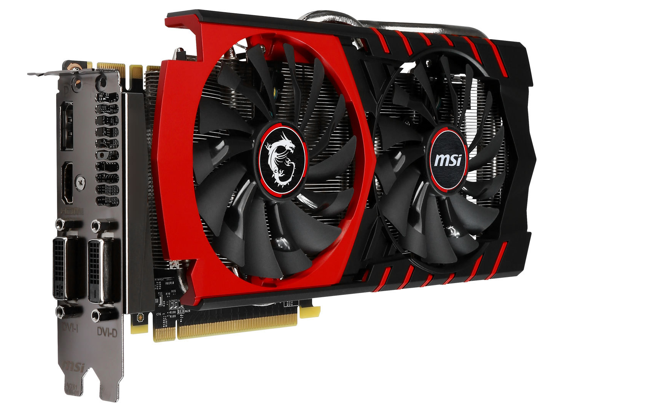
Budgetary Concerns
Currently, no expenditures have been made
No expenditures are dire for completion of the project
However, there may be a future in purchasing a graphics card/new laptop
All purchases will be made through proper channels at the university
Burke

Slide 14
Questions?

