Slide 1
Virtual Reality Research
Liam Burke and John Miscevich

Slide 2
Acknowledgements
Project Sponsor and Faculty Advisor:
Dr. Elmer Grubbs
Miscevich

Slide 3
Background and Project Overview

Slide 4
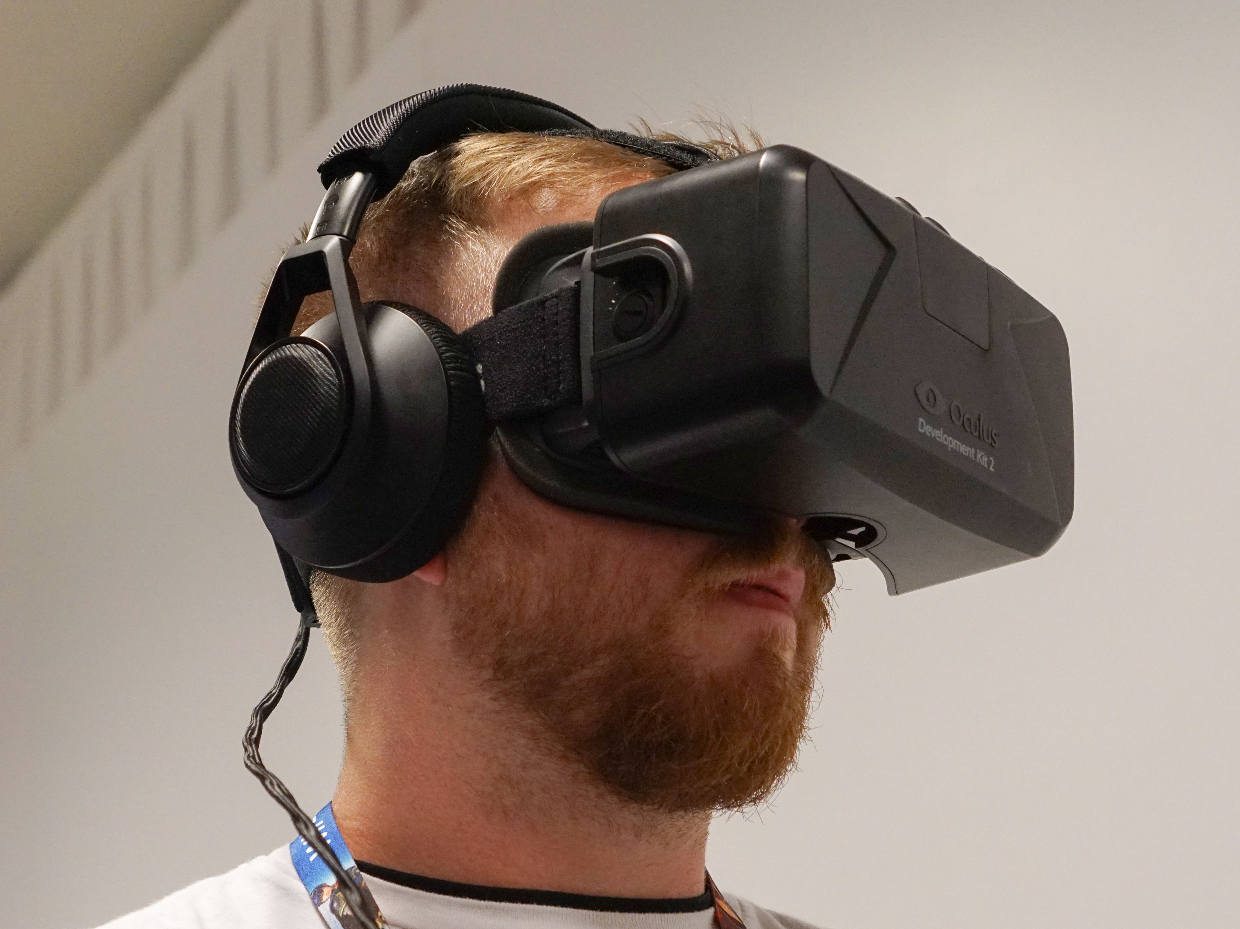
What is Virtual Reality?
Using sound and images to simulate a realistic three dimensional environment that responds to user stimulus or actions.
Burke

Slide 5
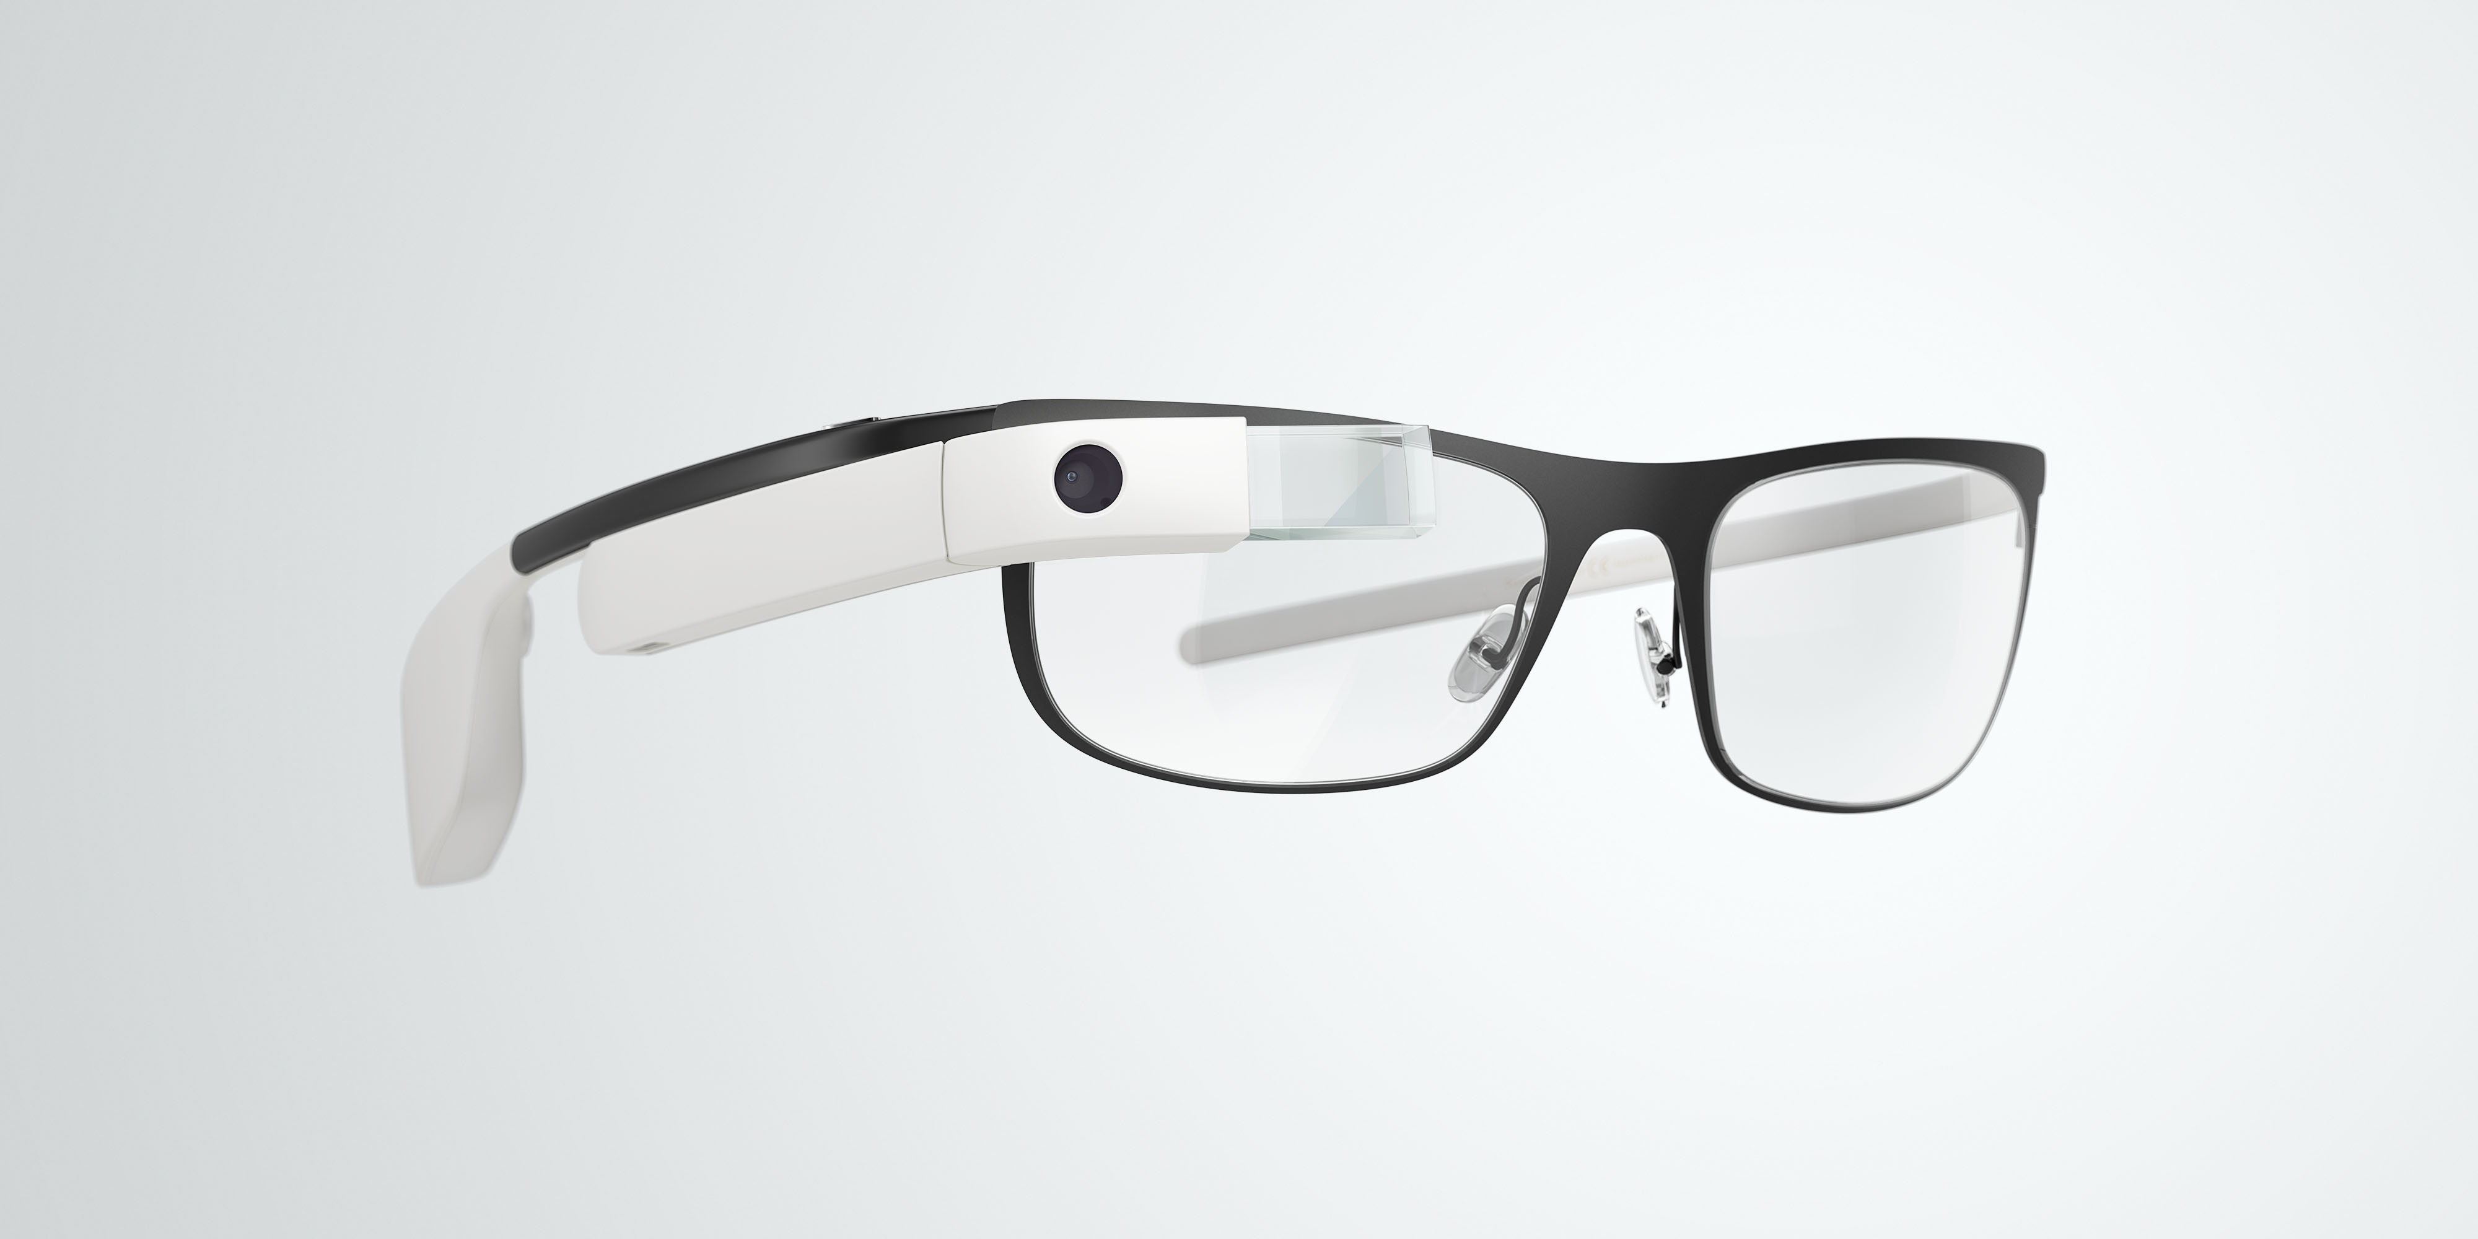
What are Motion Based Controls?
Using physical movements of the human body, either independently or in conjunction with traditional controls methods, to illicit a response from some interface.
Burke

Slide 6
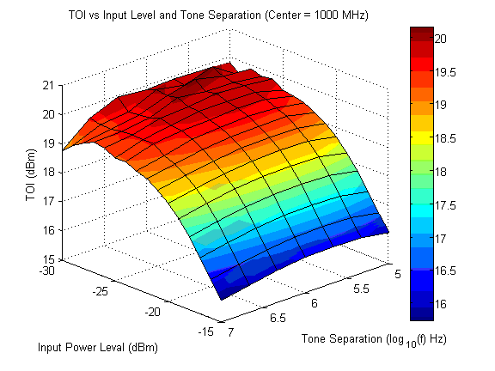
Problem Statement and Desired Outcome
Integrate virtual reality environment and motion based controls
Iconic representation of sorted data
Integrate data representation with virtual reality environment
Utilize motion controls to manipulate data representation
Miscevich

Slide 7
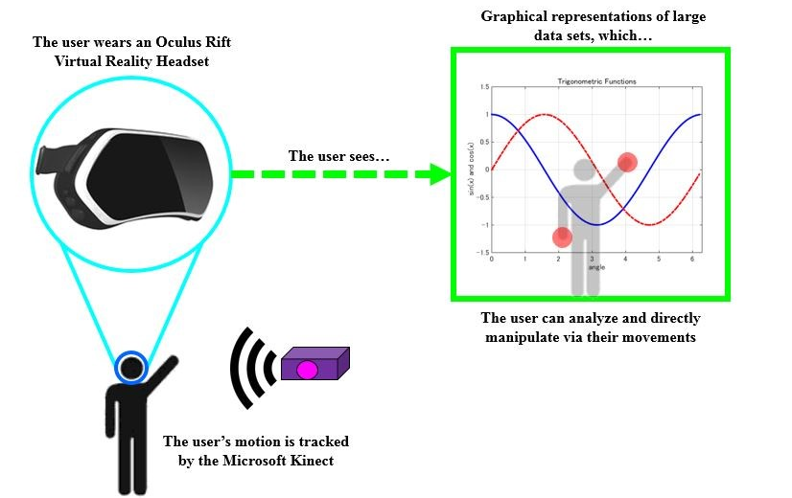
Systems Overview Diagram
Miscevich

Slide 8
Requirements and Constraints

Slide 9
Given Hardware/Software Constraints
Oculus Rift VR Headset
Microsoft Kinect
Unity Engine
➔ Oculus Rift Software
➔ Windows 8 OS
➔ Microsoft Kinect SDK
Miscevich

Slide 10
Requirements Overview
Mechanical Requirements
Interaction with physical tether (wiring)
Electrical Requirements
Must supply power to VR headset and motion tracker via personal computer
Environmental Requirements
Will be used and stored in an indoor environment
Software/GUI Requirements
Constrained to certain software
GUI must be intuitive and easy to understand
Must be upgradeable/adaptable
Most critical requirement type
Documentation Requirements
Must develop a user manual outlining how to use the product, as well as what specific gestures do
General Requirements
Sponsor needs/wants, per Dr. Grubbs’s request
Burke

Slide 11
Software/GUI Requirements
The entirety of the project consists of the implementation and design of the user interface
Must define gestures that are easy to do, intuitive, and align with what the user already understands
Documentation will be drafted to detail which gestures perform which actions
Miscevich

Slide 12
Research

Slide 13
Research Takes a Different Shape
Coding
Analyzing, understanding, and “porting” the existing code
Learning the language
Familiarity with software
Built in libraries
Online tutorials
Acquisition of necessary components
Programs
Previously existing code
IT difficulties
Miscevich

Slide 14
Questions?

