Slide 1
Virtual Reality Progress Presentation
Liam Burke and John Miscevich

Slide 2
Team Introduction
Client, Project Sponsor, and Faculty Advisor:
Dr. Elmer Grubbs
Team Members: Liam Burke and John Miscevich
Burke

Slide 3
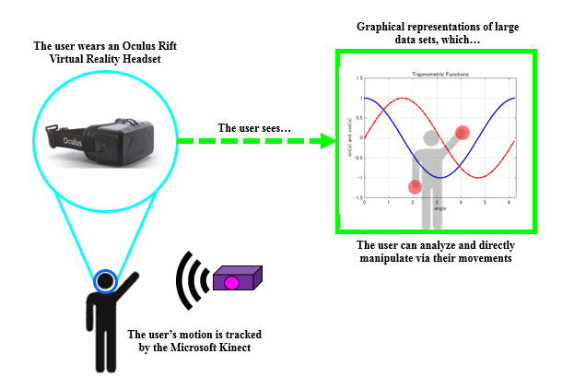
Systems Overview and Project Problem
Burke

Slide 4
New or Modified Information
Many aspects of the project have been unchanged or only slightly modified
One design decision has been made
How to graph in Unity
Two parts have been received
Laptop
Unity store Asset
Burke

Slide 5
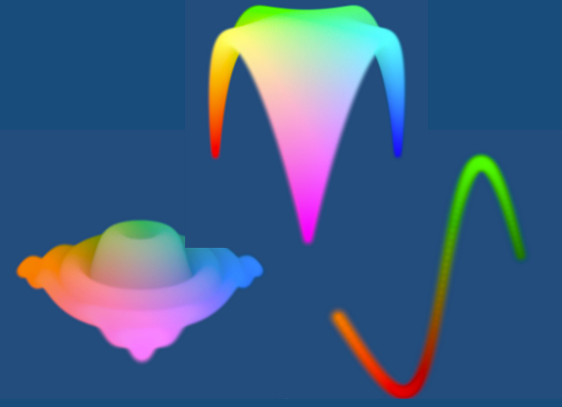
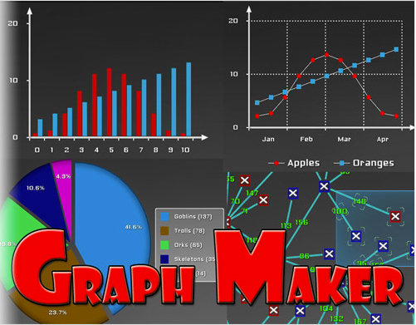
Primary Design Decision
Primary design decision revolves around graphing in Unity
Previously, we researched graphing via particle systems
Concerns: modifying the graphs, including axes, including data points
Decided on built-in Unity asset
Graph Maker
Provides clean, aesthetically labeled graphs
No external program
Miscevich

Slide 6
Overview of Accomplished Tasks
Full visualization of the Selection Scene
Full visualization of the Model and Test Type Scene
Full visualization of the Date Selection Scene
Full visualization of the Graph Scene
Full menu navigation between scenes
Full motion integration on non-graphing scenes
Burke

Slide 7
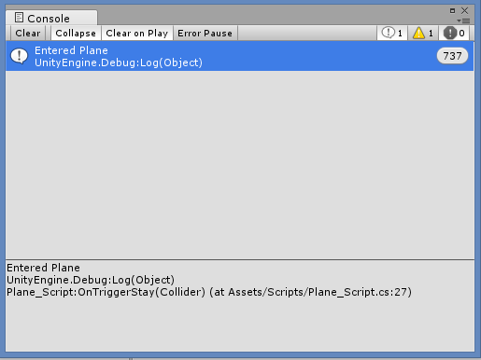
Testing
Software only based testing
Every compilation is an individual “test”
1000s of compilations
“Tests” lasting 5-10 seconds
Classified and grouped tests by objective
Qualitative, not quantitative
Miscevich

Slide 8
Visuals Testing
Virtual reality is heavily perspective based
Performed for:
Selection Scene
Parameters Scene
Dates Scene
Graphing Scene
Process of compiling code, viewing virtual environment in headset, and amending visuals
Burke

Slide 9
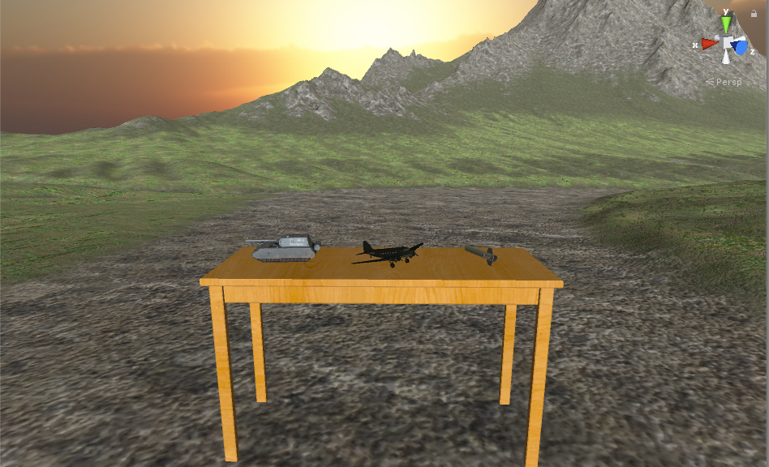

Slide 11
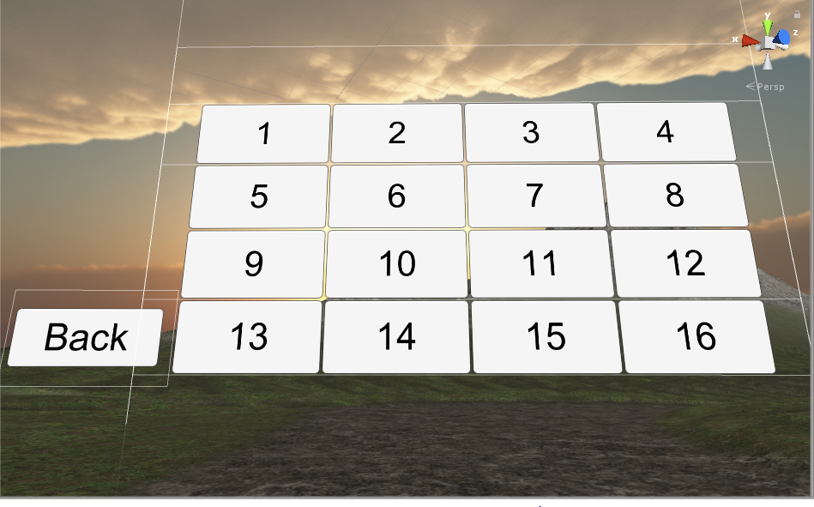

Slide 12
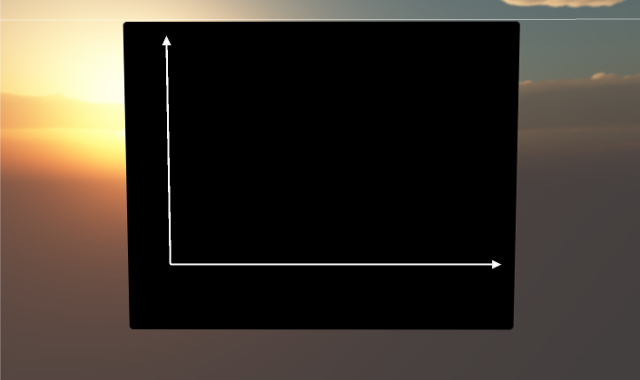

Slide 13
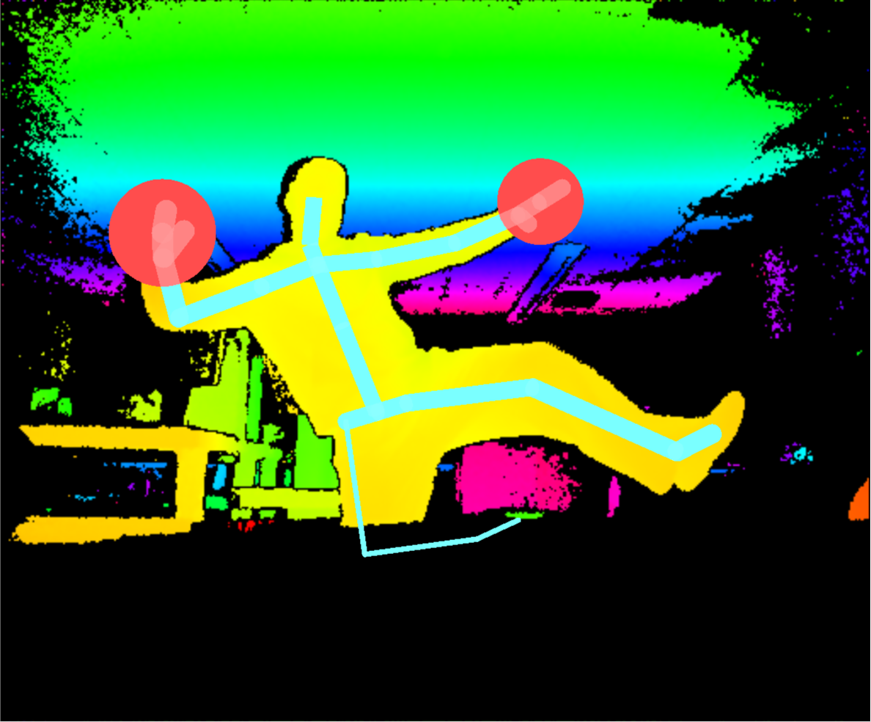
Motion Integration Testing
Making sure the user is detected by the Kinect
Visually representing the user’s motions on screen
Making sure the user is being properly tracked
Using motion controls to navigate menus
Miscevich

Slide 14
Milestones and Tasks To Be Completed (Scheduling)
Tasks
Motion and graphing integration
Importing custom data sets
Mobile application development
Overview and touch ups
Create user manual
Milestones and Deliverables
Completed user manual (April 24th, 2017)
Capstone design conference (April 28th, 2017)
Zip folder containing the code for the completed project (May 5th, 2017)
Mobile application and associated code (May 5th, 2017)
All hardware returned to Dr. Elmer Grubbs (May 5th, 2017)
Miscevich

Slide 15
Motion/Graphing Integration Testing
The process of taking the existing graph visuals and the existing motion controls, and combining the two:
How intuitive is the physical motion?
Does the motion make sense paired with the action it is supposed to perform?
Does the physical motion alter the graph in the way that it is supposed to?
Is the gesture easily detectable to the Microsoft Kinect?
Miscevich

Slide 16
Data Importation Testing
The process of providing the program with our own custom set of data for visualization:
Trial and error cycle of importing data, running code, and seeing if it appears on screen
Upon completion, user of the project will be able to insert their own data
Constant testing with mobile application to see if accelerometer data is being received
Burke

Slide 17
Final, Full Scale Testing
Ensuring that the entire project is complete and seeking out bugs and issues to resolve them:
Program should be able to run from start to finish, with all desired features fully working
Minor tweaks and additions will be made to optimize the user’s viewing experience
Intentionally try to “exploit” the project and find bugs
Potentially allow third party users to test final product for us
This final project will be accompanied by the user manual.
Miscevich

Slide 18
Capstone Budgetary Overview
One budgetary addition – Graph Maker
Necessary asset for displaying the more “tedious” portions of the graph
This is the only deviation from the original budget
This is the only predicted required expenditure for the rest of the project
Burke

Slide 19
Questions?

